Slide 1
1 Peter 2:18-25
(English Standard Version)

Slide 2
¹⁸ Servants, be subject to your masters with all respect, not only to the good and gentle but also to the unjust. ¹⁹ For this is a gracious thing, when, mindful of God, one endures sorrows while suffering unjustly. ²⁰ For what credit is it if, when you sin and are beaten for it, you endure? But if when you do good and suffer for it you endure, this is a gracious thing in the sight of God. ²¹ For to this you have been called, because Christ also suffered for you, leaving you an example, so that you might follow in his steps. ²² He committed no sin, neither was deceit found in his mouth.

Slide 3
²³ When he was reviled, he did not revile in return; when he suffered, he did not threaten, but continued entrusting himself to him who judges justly. ²⁴ He himself bore our sins in his body on the tree, that we might die to sin and live to righteousness. By his wounds you have been healed. ²⁵ For you were straying like sheep, but have now returned to the Shepherd and Overseer of your souls.

Slide 4
Hebrews 4:12–13 (ESV)
¹² For the word of God is living and active, sharper than any two-edged sword, piercing to the division of soul and of spirit, of joints and of marrow, and discerning the thoughts and intentions of the heart. ¹³ And no creature is hidden from His sight, but all are naked and exposed to the eyes of Him to whom we must give account.

Slide 5
At war with the Passions of the Flesh – The attitude, “You’re not the boss of me”
For the Lord’s sake: have an attitude of submission & not ‘lord it over’ others
^{ESV 18} Servants, be subject to [submit to] your masters with all respect, not only to the good and gentle but also to the unjust.
Household servants (often slaves)
There are good masters/employers and there are crooks...
(Literal translation from Greek) 18 Domestic servants, be subjecting yourselves in all fear, to the masters, not only to the good and gentle, but to the crooked…
Peter continues his train of thought:– Out of our fear/respect of God, submit to all
Submit to your boss. Even if s/he is a nasty crook. (Loyalty to God overrides this, if instructed to do something illegal or against God’s Law)
Honour God by being the very best servant you can be
God has shown us Grace. Therefore we show grace to all people (even if they don’t deserve it.
¹⁹ For this is a gracious thing, when, mindful of God, one endures sorrows while suffering unjustly.

Slide 6
At war with the Passions of the Flesh – The attitude, “You’re not the boss of me”
For the Lord’s sake: have an attitude of submission & not ‘lord it over’ others
^{ESV 18} Servants, be subject to [submit to] your masters with all respect, not only to the good and gentle but also to the unjust.
Household servants (often slaves)
There are good masters/employers and there are crooks...
Peter continues his train of thought:– Out of our fear/respect of God, submit to all
Submit to your boss. Even if s/he is a nasty crook. (Loyalty to God overrides this, if instructed to do something illegal or against God’s Law)
Honour God by being the very best servant you can be
God has shown us Grace. Therefore we show grace to all people (even if they don’t deserve it.)
Disciples of Jesus have been called to suffer for Jesus
²¹ For to this you have been called, because Christ also suffered for you, leaving you an example, so that you might follow in his steps.

Slide 7
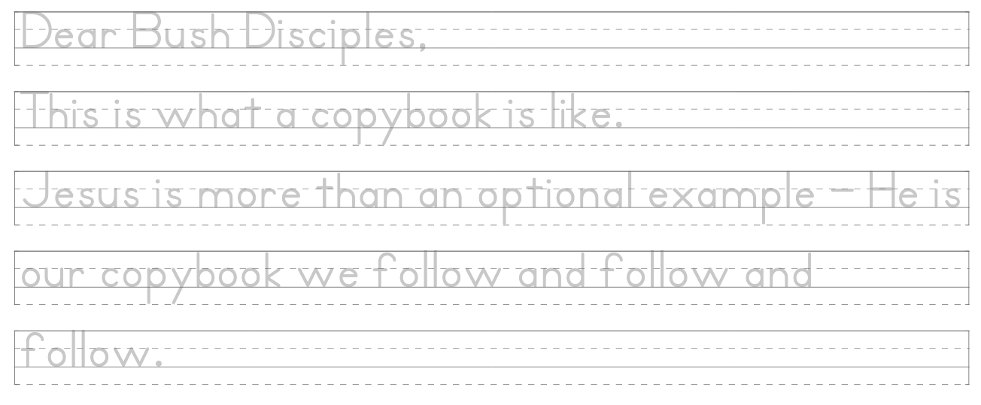
The commonest use of the noun (cf. the vb. hypographō) is for the faint outlines of letters which were traced over by pupils learning to write, then also of the sets of letters written at the top of a page … to be copied repeatedly by the learner on the rest of the page.
Bruce, F.F., 1986. ὑπογραμμός L. Coenen, E. Beyreuther, & H. Bietenhard, eds. New international dictionary of New Testament theology.

Slide 8
At war with the Passions of the Flesh – The attitude, “You’re not the boss of me”
For the Lord’s sake: have an attitude of submission & not ‘lord it over’ others
^{ESV 18} Servants, be subject to [submit to] your masters with all respect, not only to the good and gentle but also to the unjust.
There are good masters/employers and there are crooks...
Peter continues his train of thought:– Out of our fear/respect of God, submit to all
Submit to your boss. Even if s/he is a nasty crook. (Loyalty to God overrides this, if instructed to do something illegal or against God’s Law)
Honour God by being the very best servant you can be
God has shown us Grace. Therefore we show grace to all (even if deserved.)
Disciples of Jesus have been called to suffer for Jesus
Jesus is the copybook example. We follow the example of Jesus.
Jesus demonstrated His strength in submission
Injustice doesn’t go unnoticed. God will judge justly.
Submission only makes sense in the light of the Gospel
Ultimate righteousness is demonstrated on the cross – Jesus suffered unjustly
Isaiah prophecy – Jesus is the “Suffering Servant”
The Gospel necessity of submission – We witness to Christ in our patient suffering

